Slide 1


By
Deepa G
By
DEEPA G

Slide 2

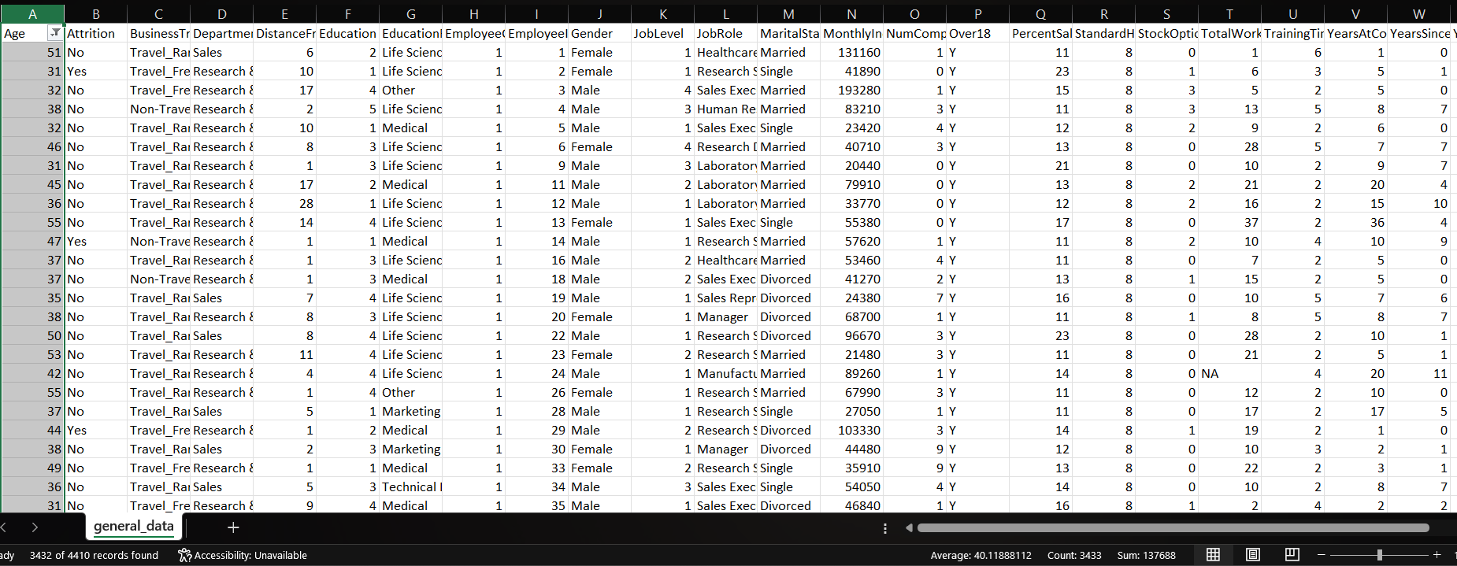
Q1. Using Excel, how would you filter the dataset to only show employees aged 30 and above?

Slide 3
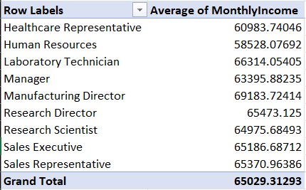
Q2. Create a pivot table to summarize the average Monthly Income by Job Role

Slide 4
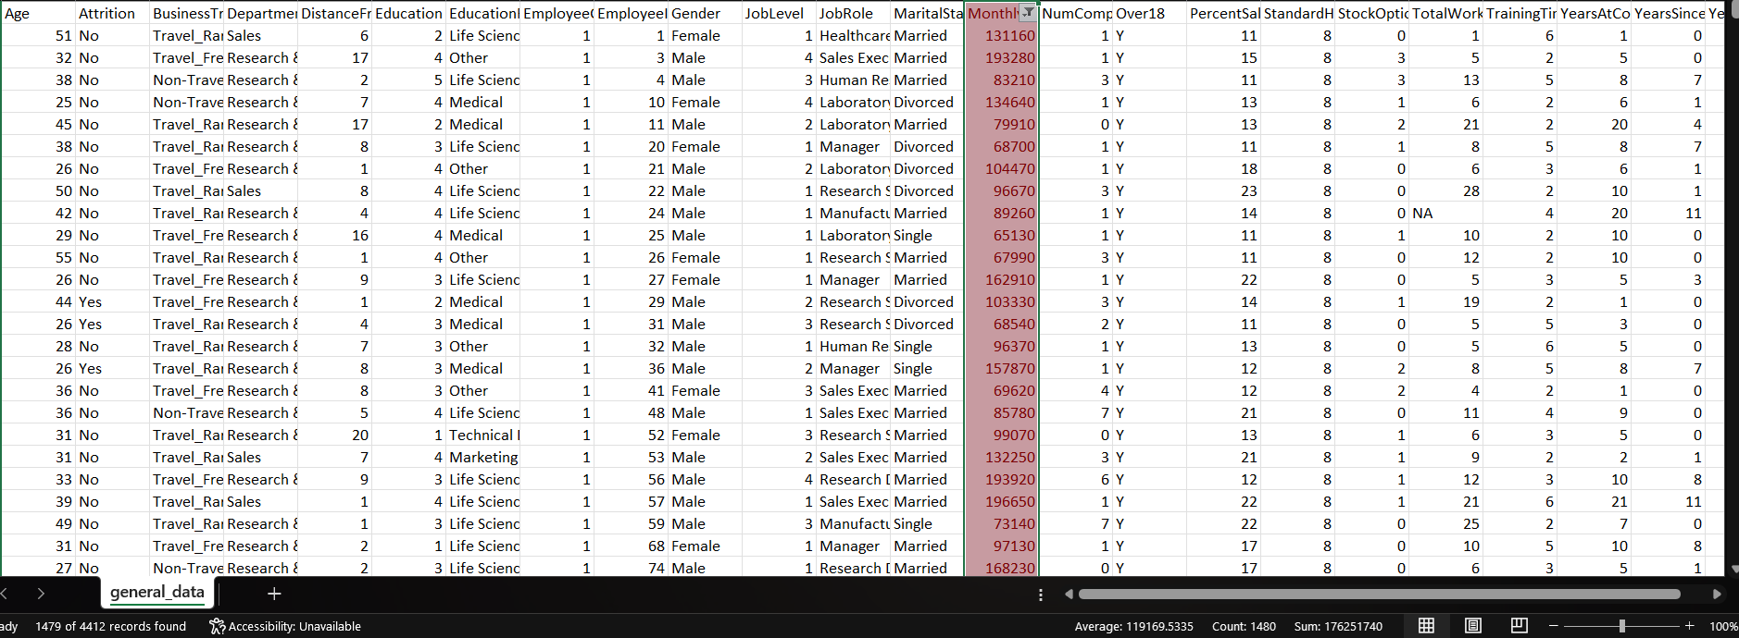
Q3. Apply conditional formatting to highlight employees with Monthly Income above the company’s
average income.

Slide 5
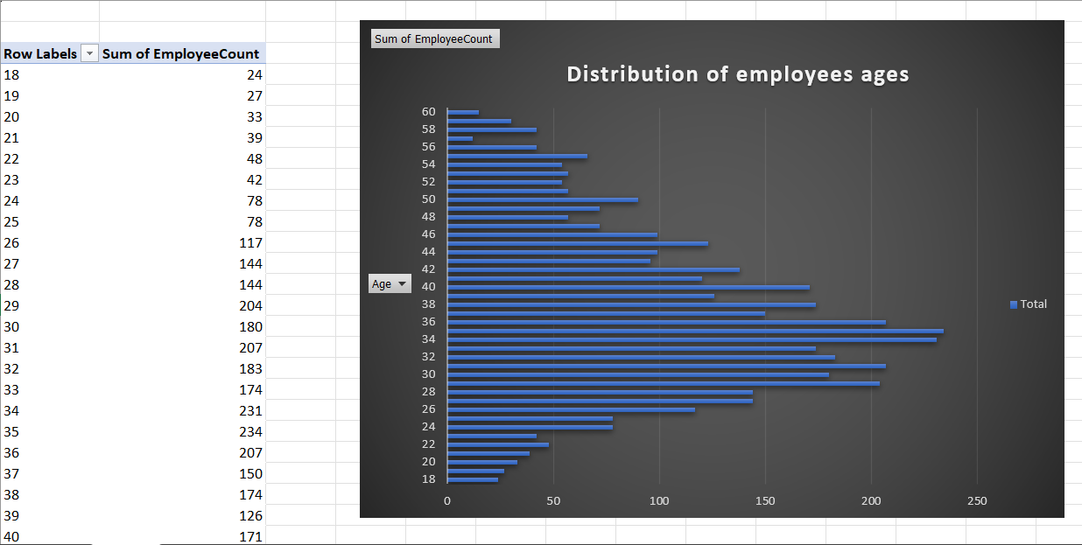
Q4. Create a bar chart in Excel to visualize the distribution of employee ages.

Slide 6
Q5.Identify and clean any missing or inconsistent data in the "Department" column.
The department column indicates that the data is consistent,
Clean , and doesn’t have any missing values.

Slide 7
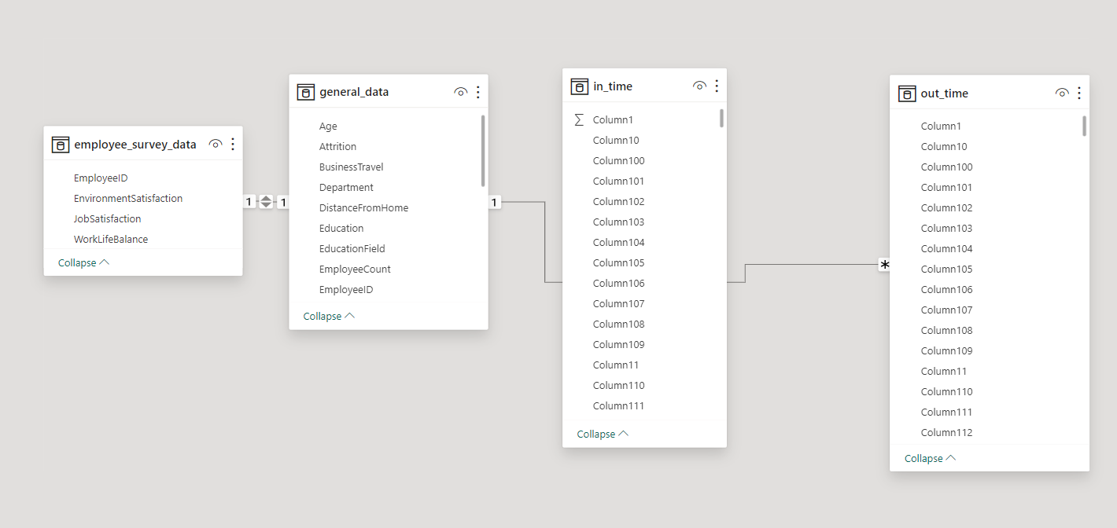
Q6. In Power BI, establish a relationship between the "EmployeeID" in the employee data
and the "EmployeeID" in the time tracking data.

Slide 8
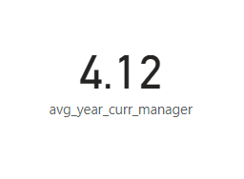
Q7. Using DAX, create a calculated column that calculates the average years an employee has
spent with their current manager.

Slide 9
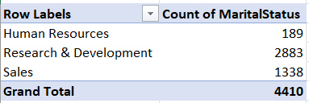
Q8. Using Excel, create a pivot table that displays the count of employees in each Marital Status category,
segmented by Department.

Slide 10
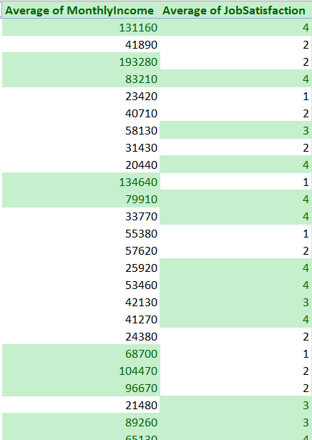
Q9. Apply conditional formatting to highlight employees with
both above-average Monthly Income and above-average Job Satisfaction.

Slide 11
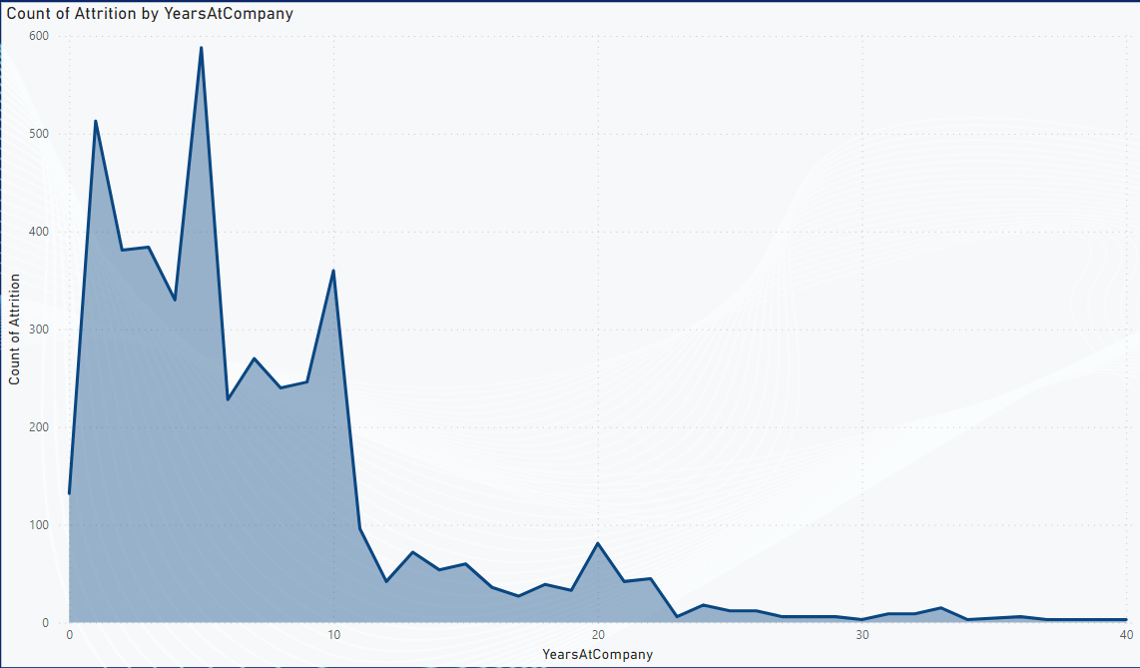
Q10.In Power BI, create a line chart that visualizes the trend of Employee Attrition over the years.

Slide 12
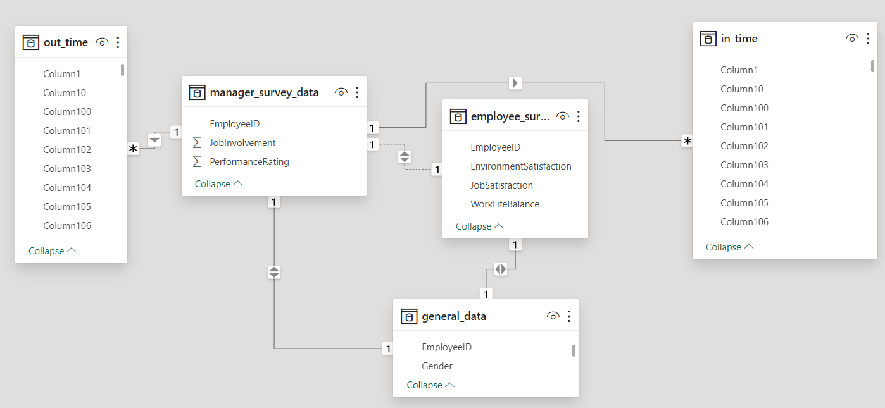
Q11. Describe how you would create a star schema for this dataset, explaining
the benefits of doing so.
Star schemas are easy to understand and navigate. The separation
of dimensions and facts simplifies the structure, making it intuitive for
users to query and analyze data.

Slide 13
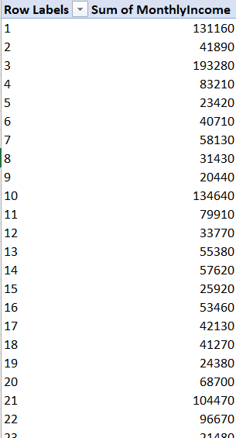
Q12. Using DAX, calculate the rolling 3-month average of Monthly Income for each employee.
The DAX formula for the rolling 3-month average of monthly income per employee
helps to analyze individual employee’s financial growth.

Slide 14
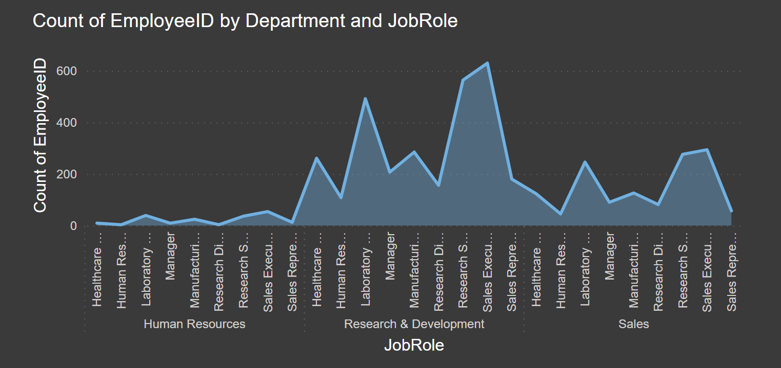
Q13.Create a hierarchy in Power BI that allows users to drill down from
Department to Job Role to further narrow their analysis.

Slide 15
Q14. How can you set up parameterized queries in Power BI to allow users to filter data based
on the Distance from Home column?
In Power BI, you can set up parameterized queries using parameters to allow users to filter data
dynamically based on the "Distance from Home" column
Load your Data
Create a Parameter
Modify Query using the Parameter
Use the Parameter in Visualizations
Test and refine

Slide 16
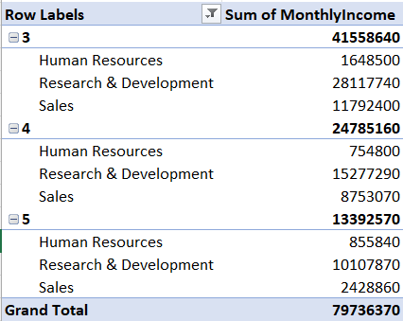
Q15. In Excel, calculate the total Monthly Income for each Department, considering only
the employees with a Job Level greater than or equal to 3.

Slide 17
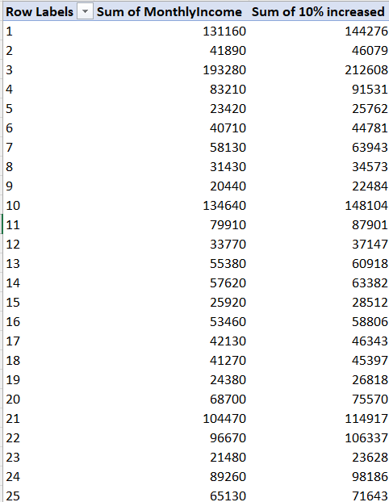
Q16. Explain how to perform a What-If analysis in Excel to understand the impact of a 10% increase
in Percent Salary Hike on Monthly Income.

Slide 18
Q17. Verify if the data adheres to a predefined schema. What actions would you take if
you find inconsistencies
If the data adheres to a predefined schema , compare fields against schema
requirements. If inconsistencies arise , address data anomalies through cleansing,
normalization, and validation procedures.

Slide 19

THANK YOU

